Slide 1
AWS S3 Encryption KMS Key
Key Management Service
Presented By KV Prem Kumar

Slide 2
Amazon S3 encryption with a KMS:
S3 Encryption refers to the process of securing data stored in Amazon S3 (Simple Storage Service) by converting it into an unreadable format unless decrypted with a proper key. This ensures that sensitive data is protected both when it's being stored (at rest) and when it's being transferred (in transit).
Amazon S3 encryption with a KMS (AWS Key Management Service) key is a way to ensure that your data stored in Amazon S3 is encrypted at rest using a customer-managed key (CMK) in AWS KMS. This offers an additional layer of security and allows you to control access to the encryption keys.

Slide 3
Types of Encryption in S3 Using KMS
Amazon S3 provides Server-Side Encryption (SSE) with KMS keys, which comes in the following forms:
SSE-KMS (Server-Side Encryption with AWS KMS-managed keys):
This uses an AWS managed KMS key to encrypt and decrypt your S3 objects.
It can be configured in S3 bucket settings or during an individual object upload.
SSE-KMS with a Customer-Managed KMS Key:
This allows you to create and manage your own KMS keys.
You have full control over permissions and key policies for encryption and decryption operations.

Slide 4
Benefits of Using SSE-KMS
Centralized Key Management: You can manage, audit and control the encryption keys used to encrypt your S3 objects.
Key Rotation: AWS KMS supports automatic key rotation.
Access Control: You can define fine-grained access control for your encryption keys through KMS policies, IAM policies, and S3 bucket policies.
Auditability: AWS CloudTrail logs KMS key usage, allowing you to track who encrypted or decrypted data.

Slide 5
Steps to Set Up S3 Encryption with KMS
Login to the AWS Account.
In the console search for IAM in the search bar.

Slide 6
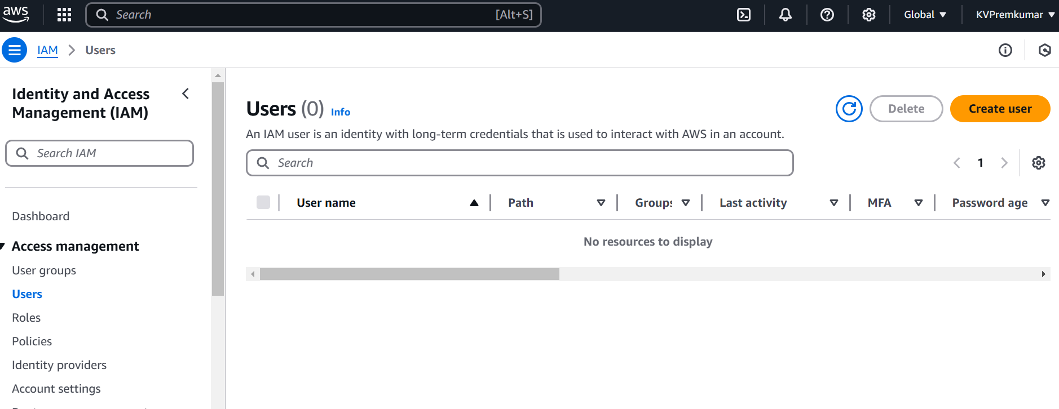
In users page Click on Create user.

Slide 7
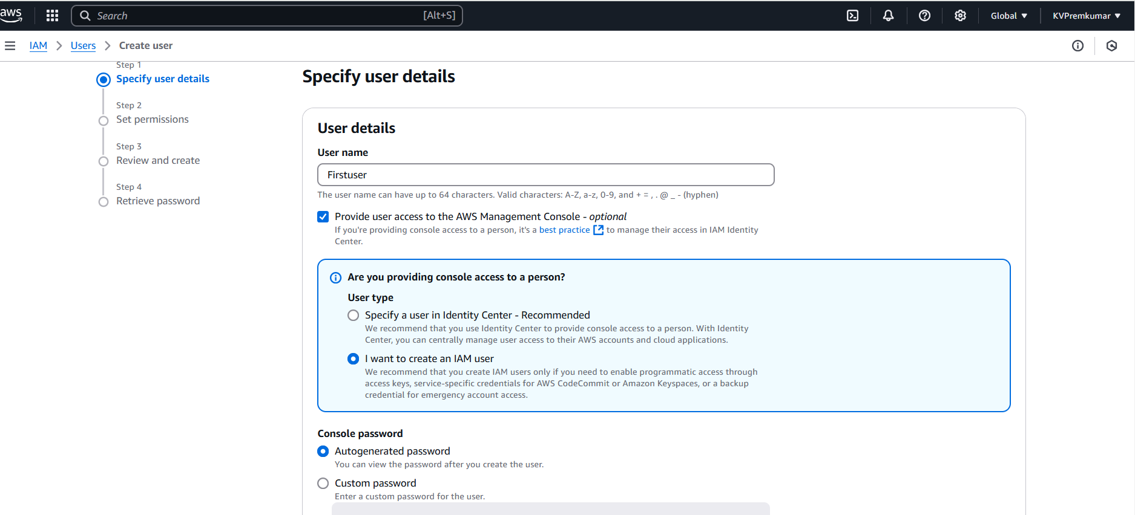
Give the user name (like Mainuser and Sideuser).
Select the option Provide user access to AWS management console.
Select the option I want to create an IAM user.

Slide 8
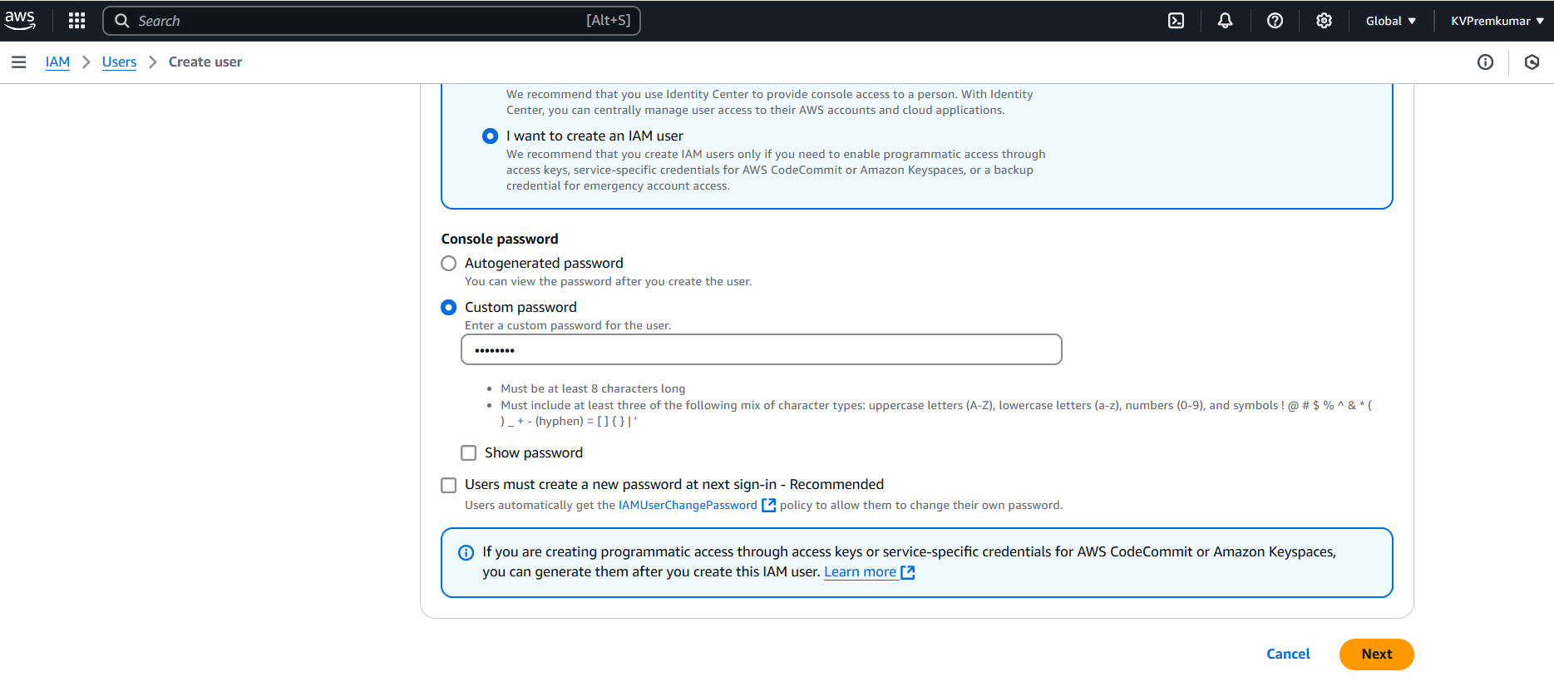
Give the custom password and click on Next.

Slide 9
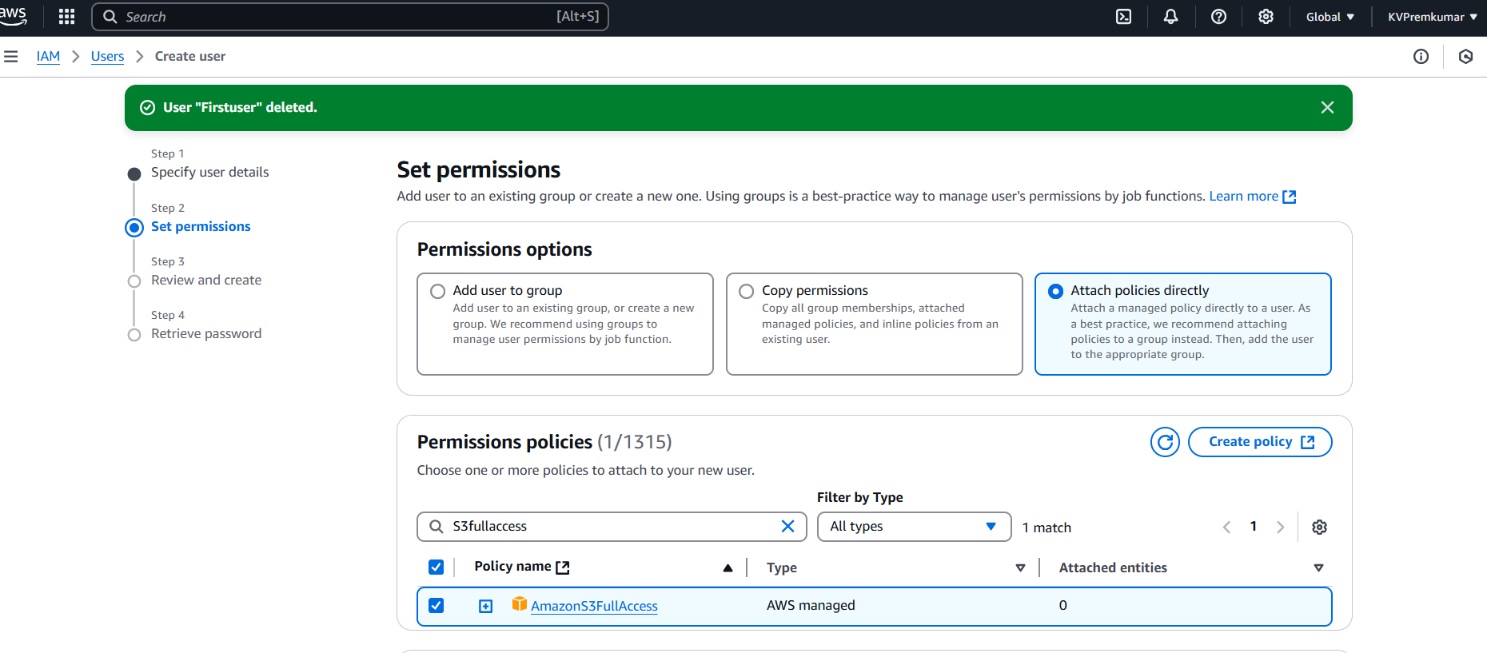
Select the option Attach policies directly in the permissions.
In the Permission Policies select S3FullAccess policy and click on Next.

Slide 10
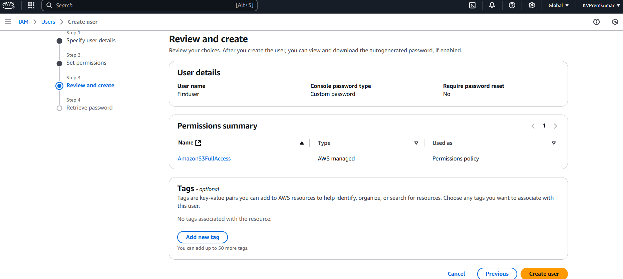
Check the review details and click on Create user.

Slide 11
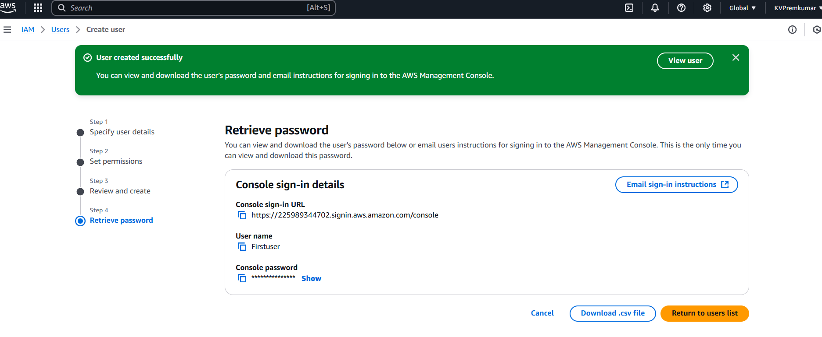
Copy the credentials and click on Return to users list.
Repeat the same process to create another user.

Slide 12
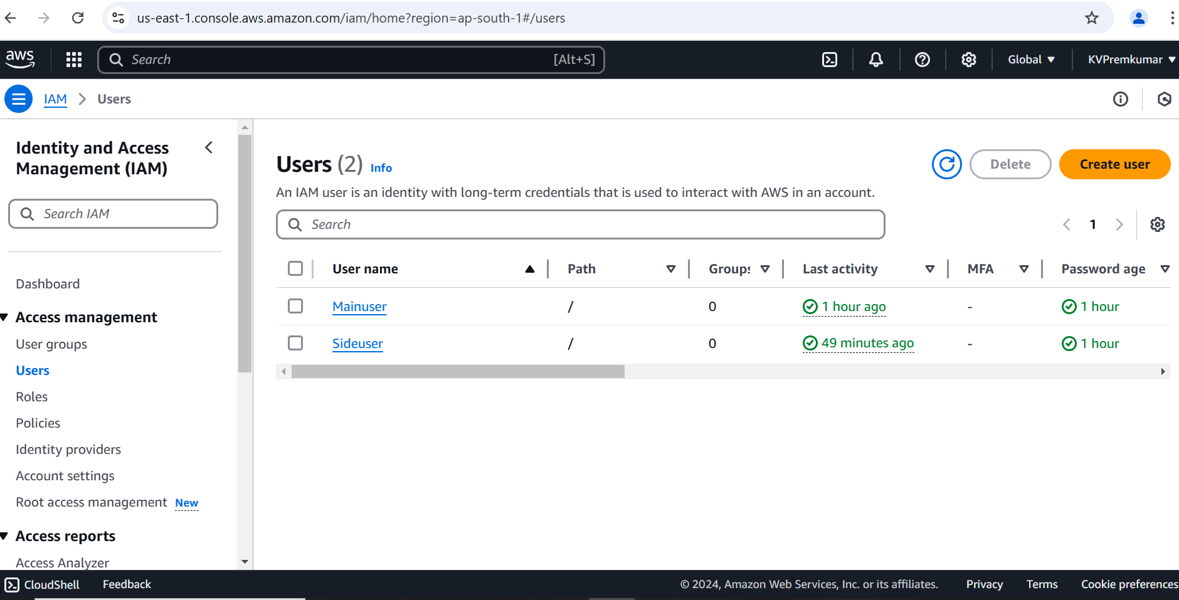
Here we can see the two IAM users created.

Slide 13
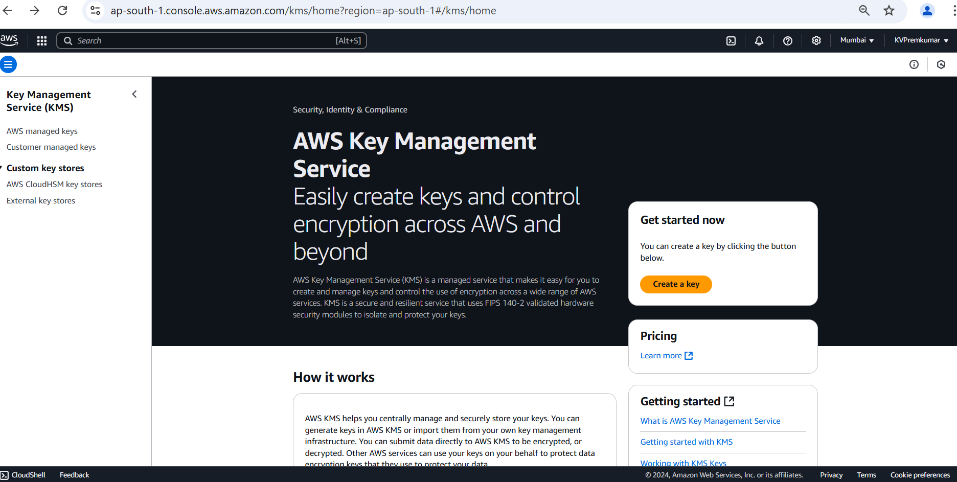
Go to the AWS KMS console
Select Create a key to create a new customer-managed key.

Slide 14
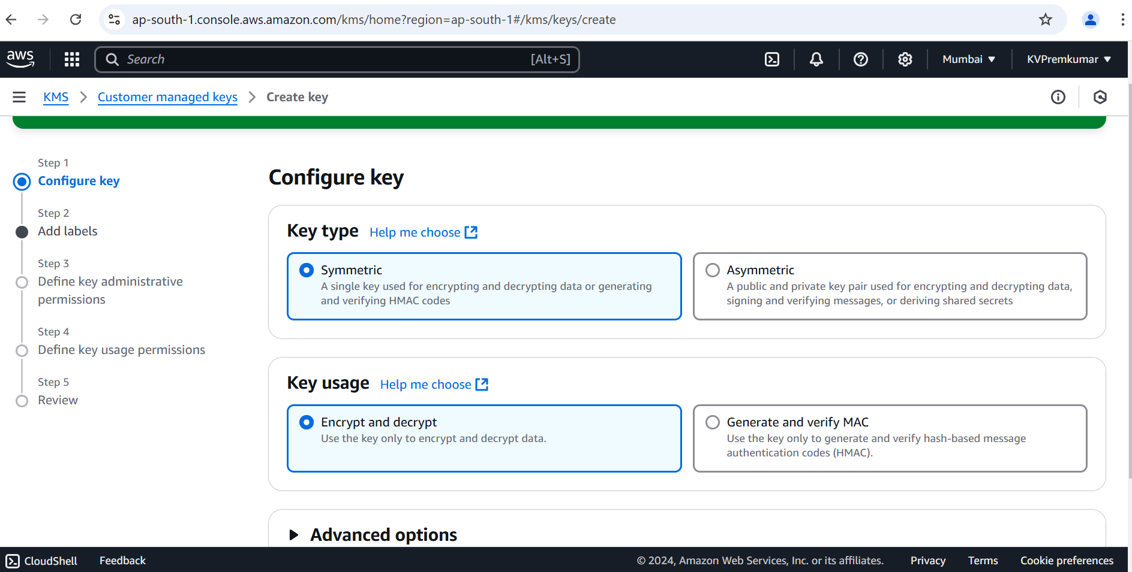
Choose the Symmetric key type (default) and click on Next.

Slide 15
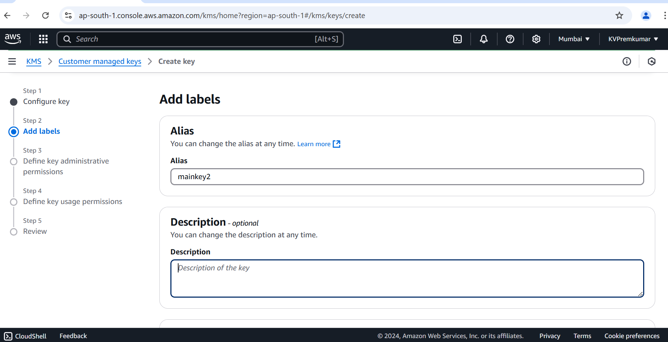
Give the key name in Alias and Description (optional) and click on Next.

Slide 16
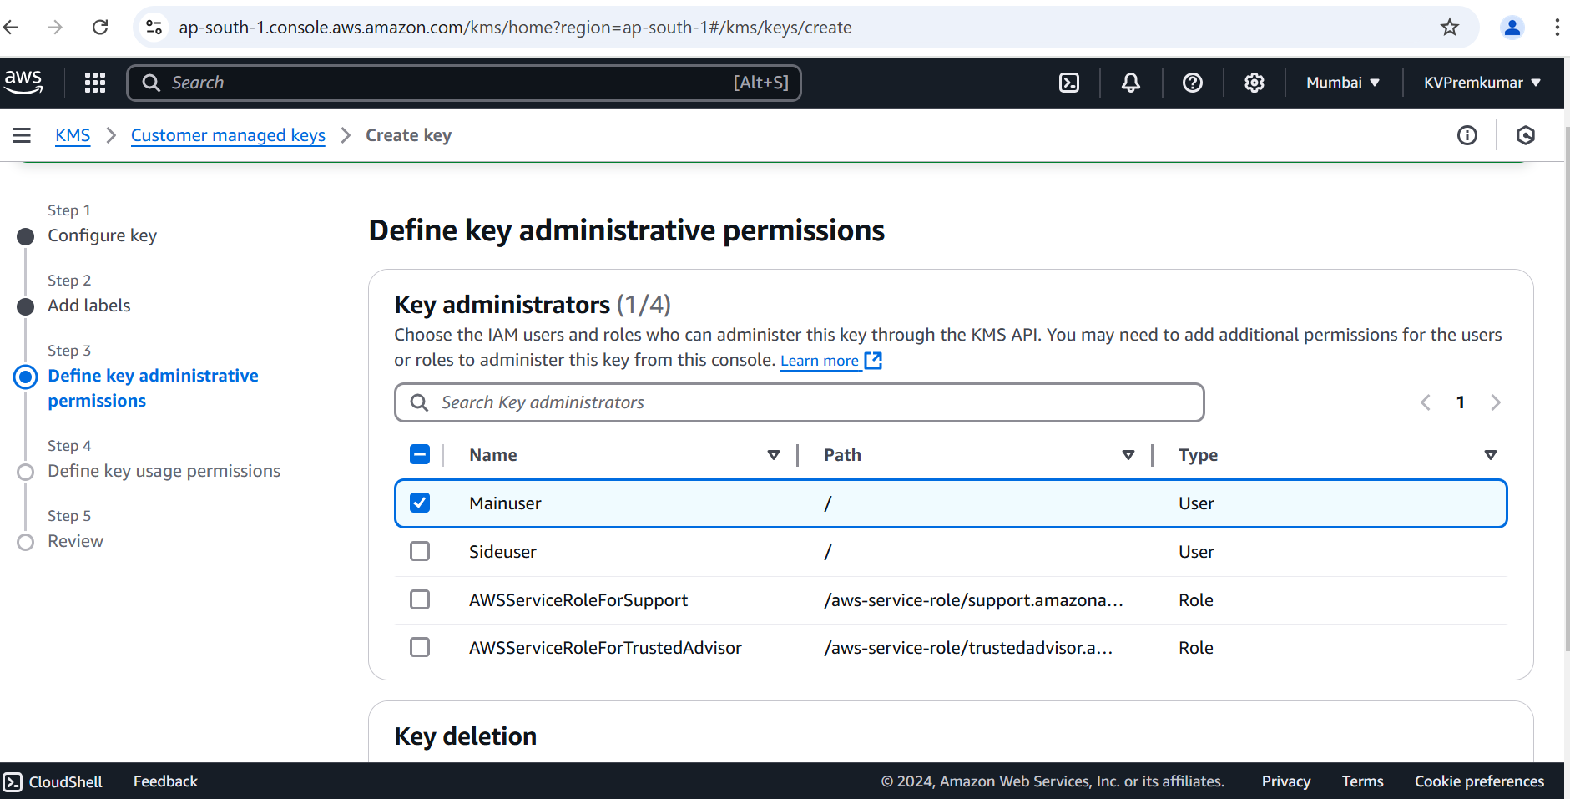
Specify key administrators (users/roles who can manage the key) and click on Next.

Slide 17
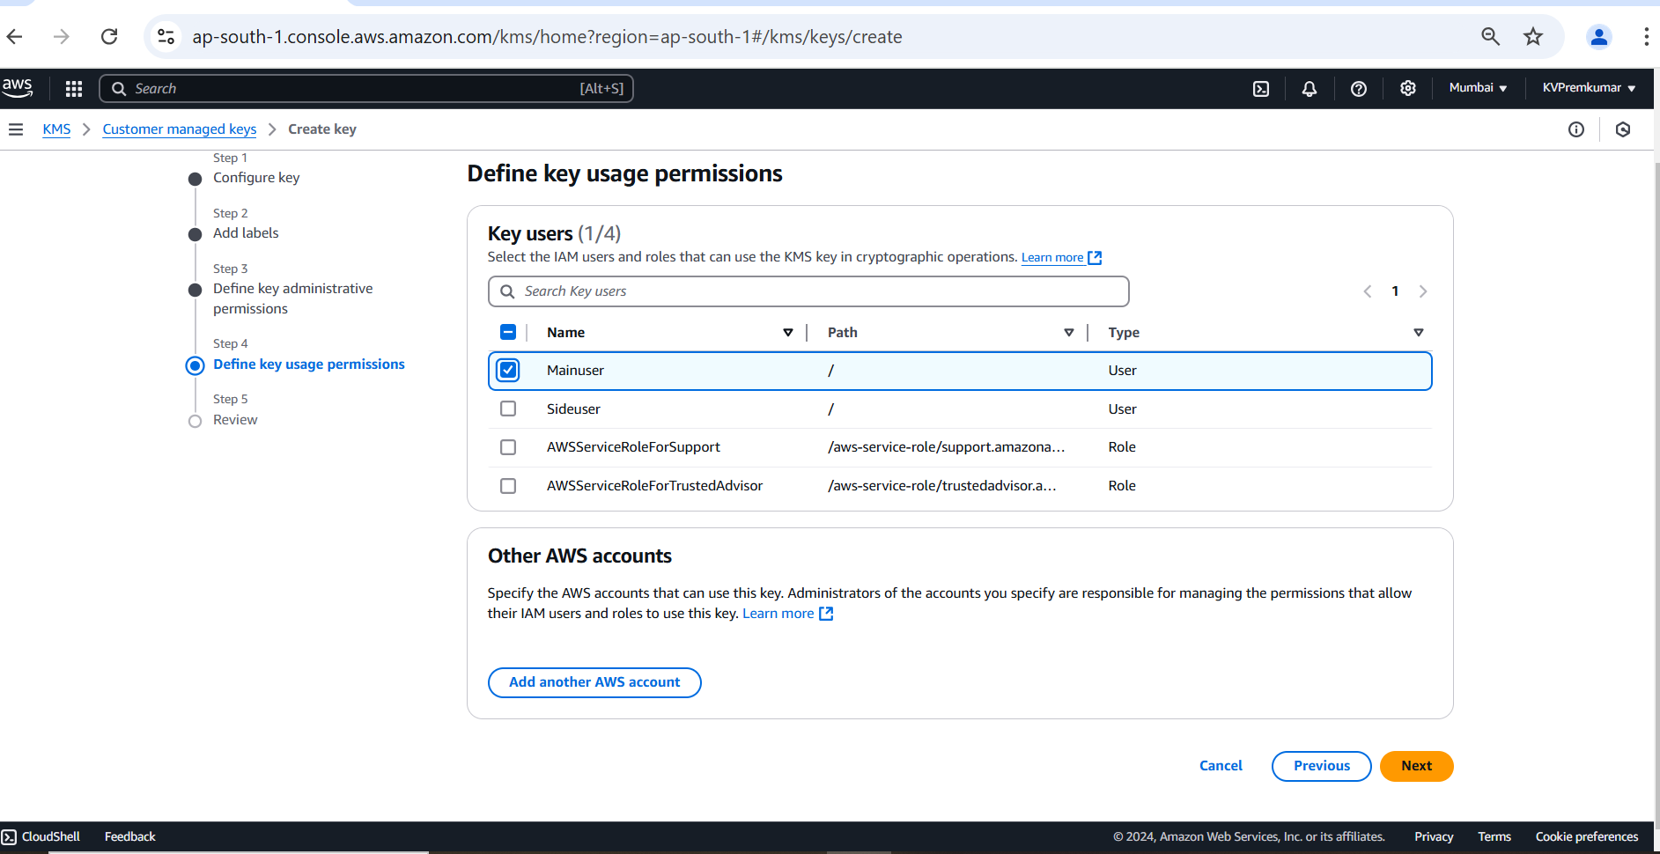
Set up key usage permissions (who can encrypt and decrypt data using the key) and click on Next.

Slide 18
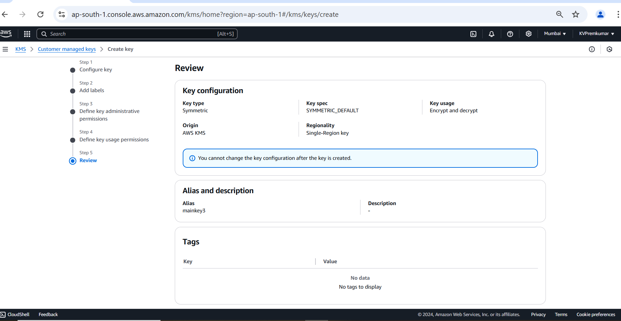
This is the Review of creating the Key (configurations, Alias, Description and Key policy).

Slide 19
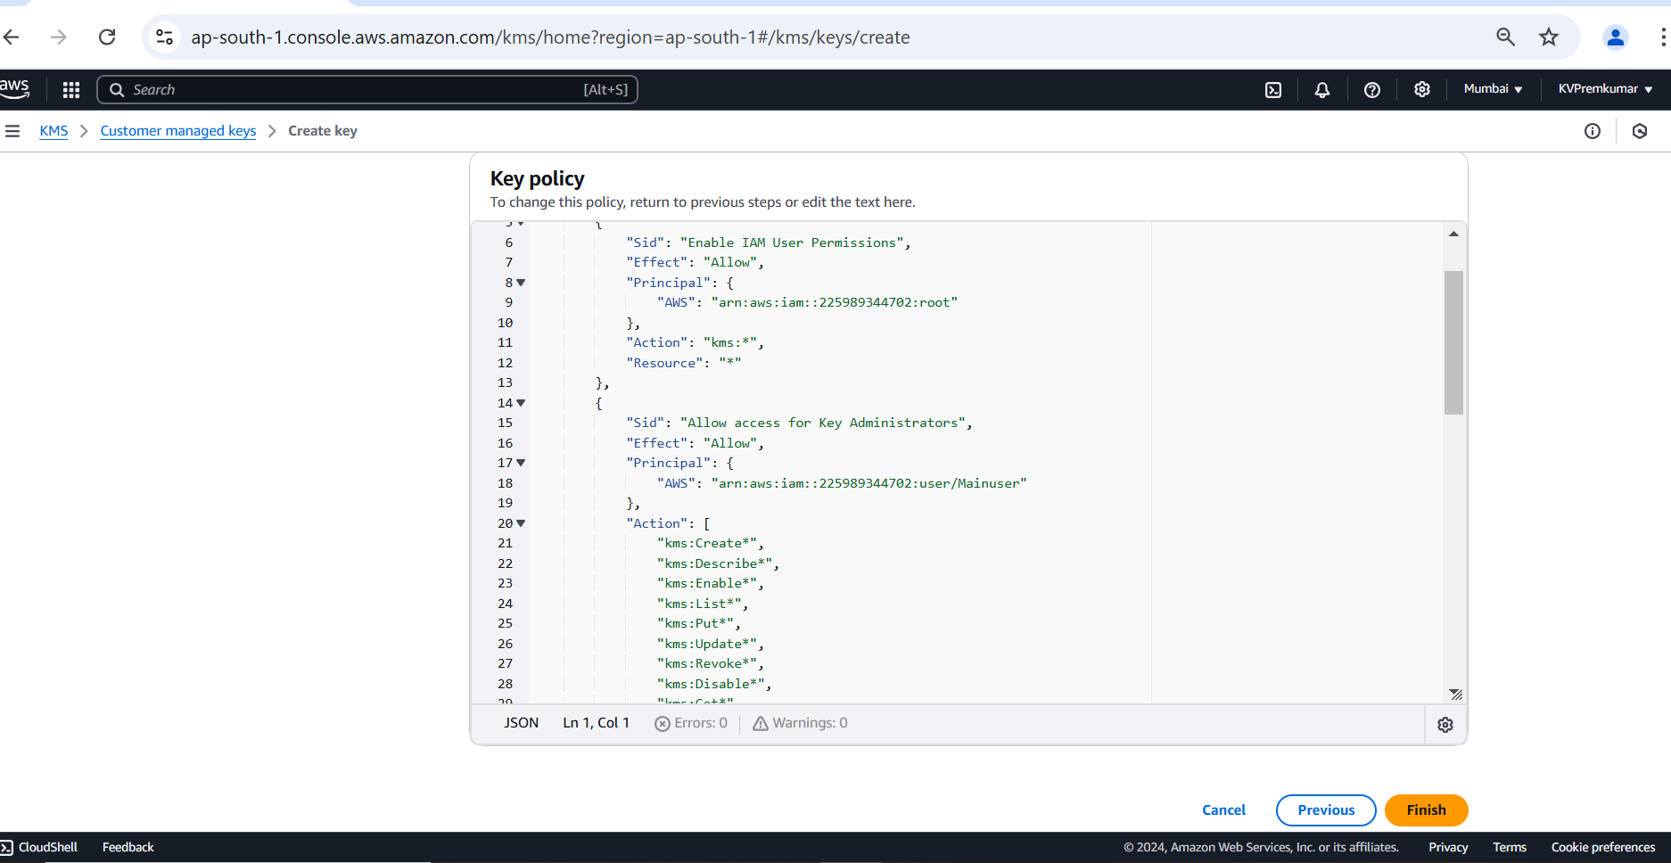

Slide 20
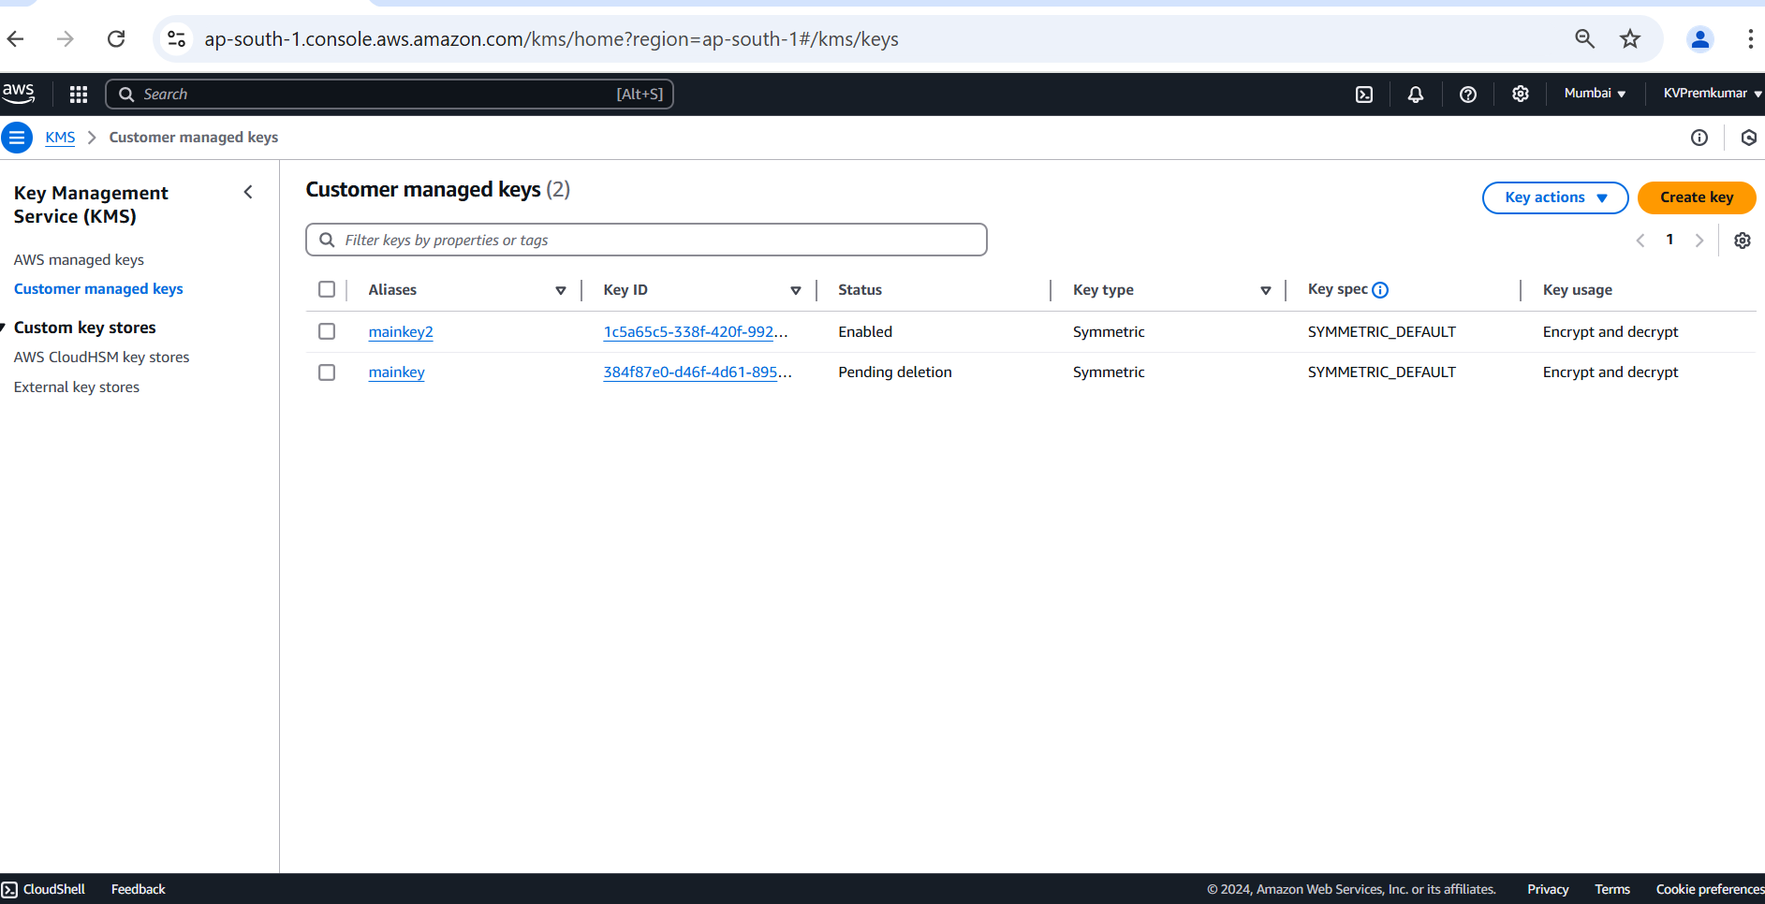
Once the key is created, we can see the key ID, status, type, usage.

Slide 21
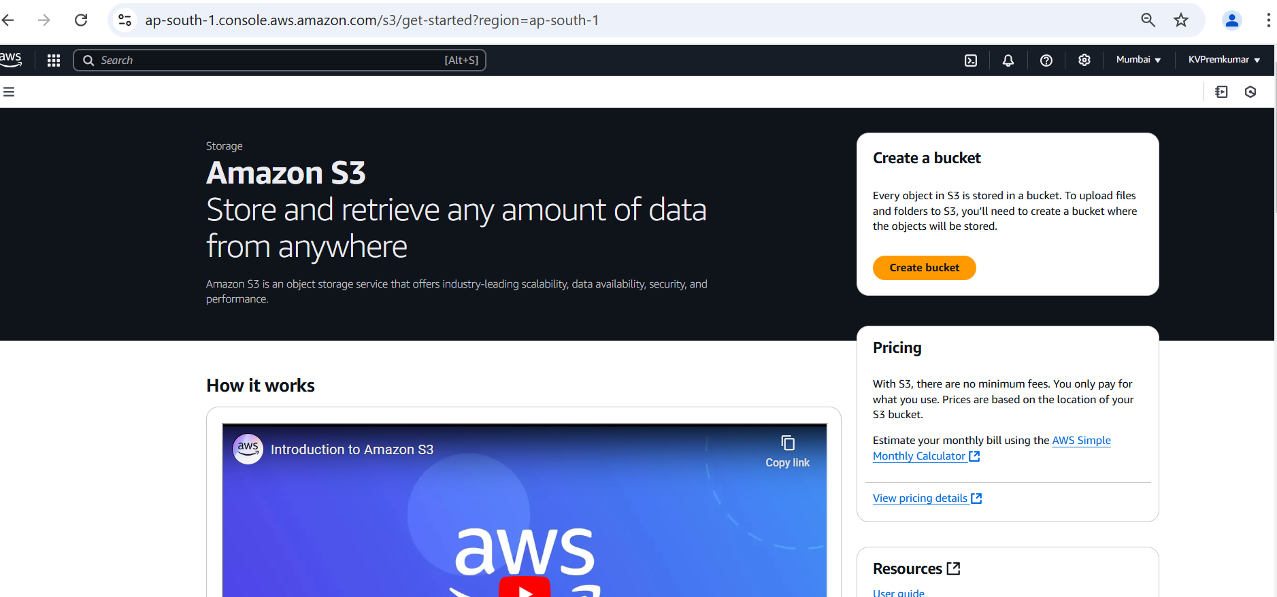
Go to the S3 console.
Click on Create Bucket.

Slide 22
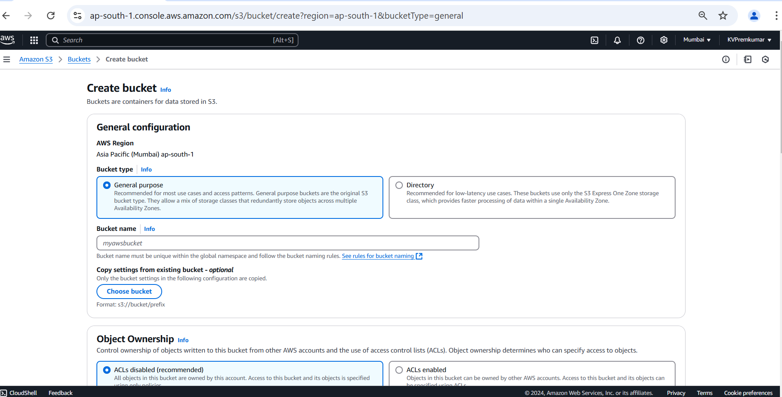
Select bucket type as General purpose.
Give the unique name to the bucket in the lowercase.

Slide 23
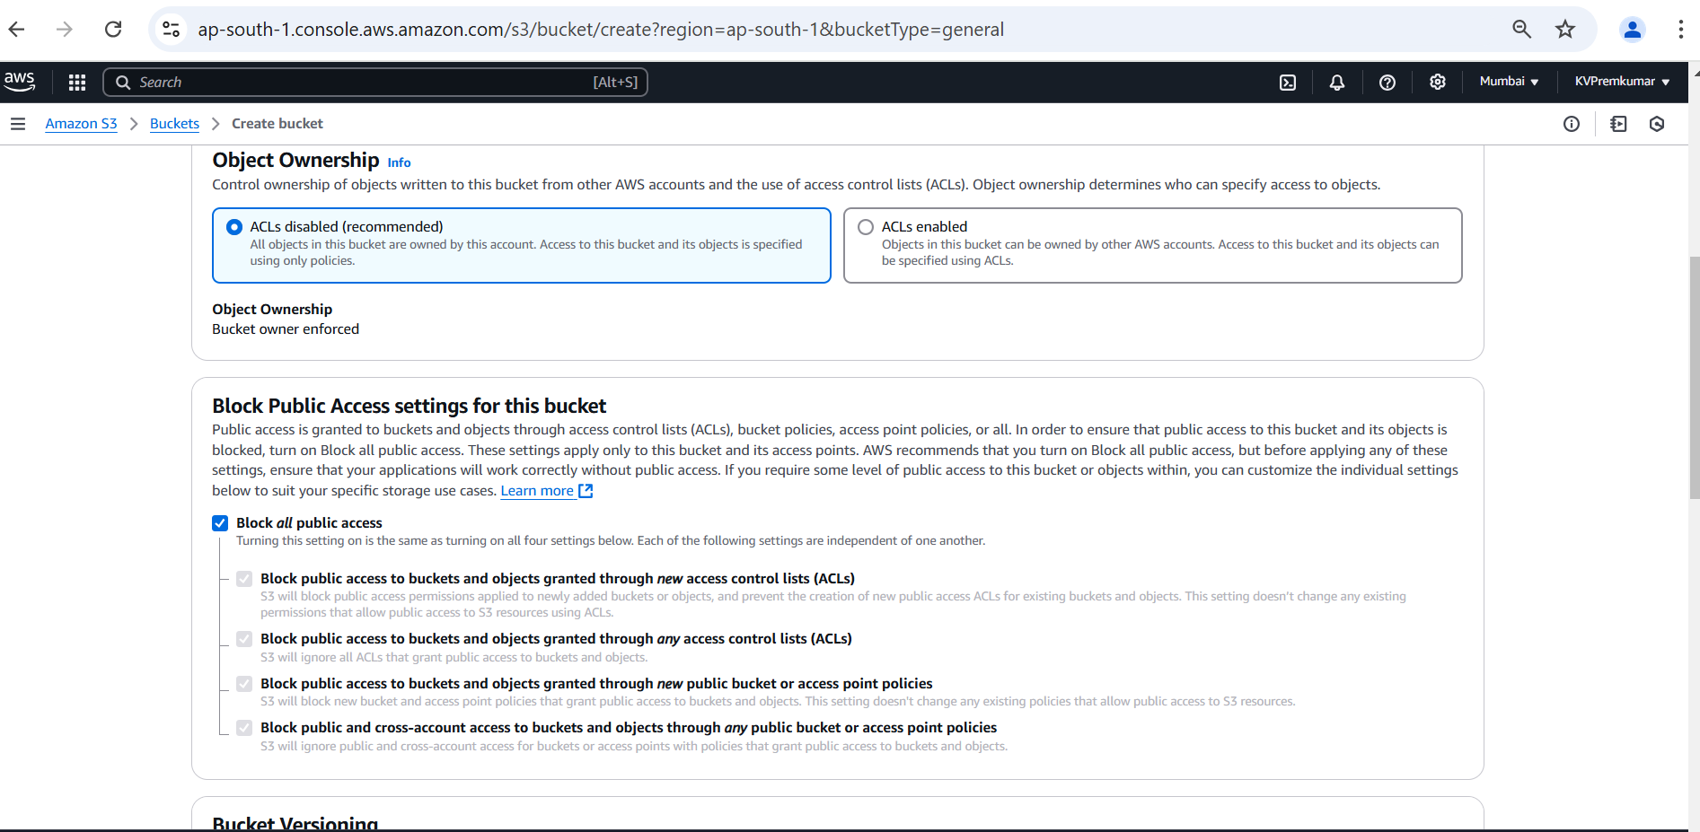
Keep the remaining as default.

Slide 24
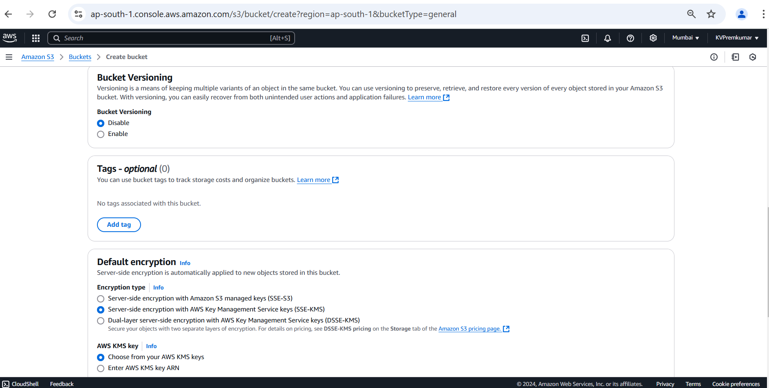
In the encryption type select AWS Key Management Service key (SSE-KMS).

Slide 25
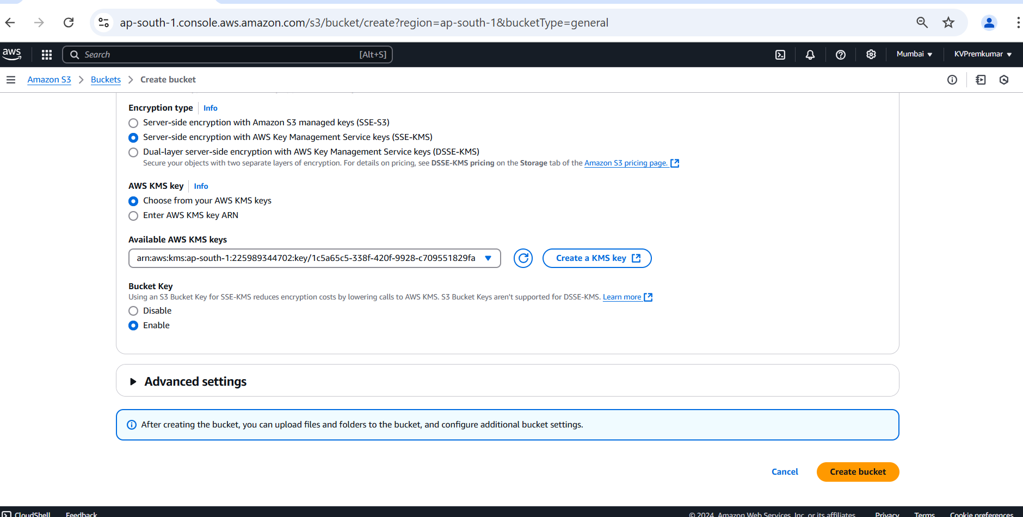
In AWS KMS key select the option choose from your AWS KMS keys.
Choose the key which is existed and Enable the bucket key.

Slide 26
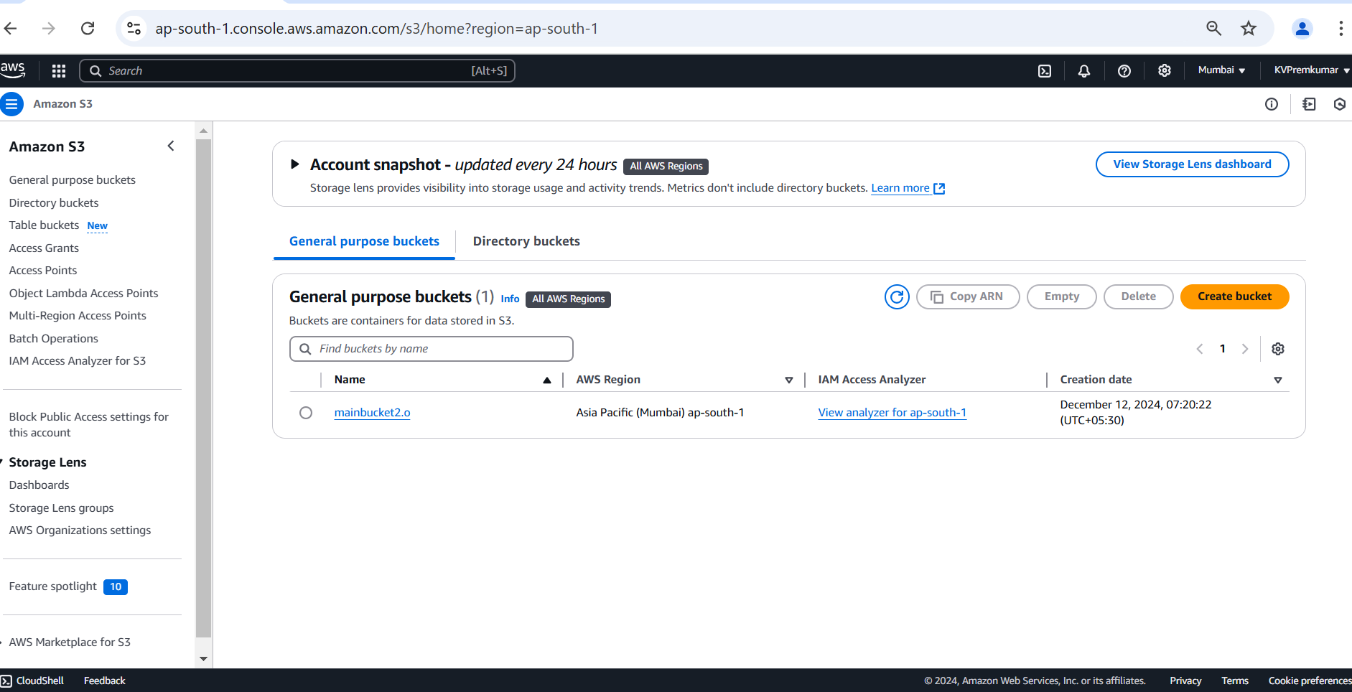
Once the bucket is created, we can see the bucket with region.
Click on the bucket name and open the bucket.

Slide 27
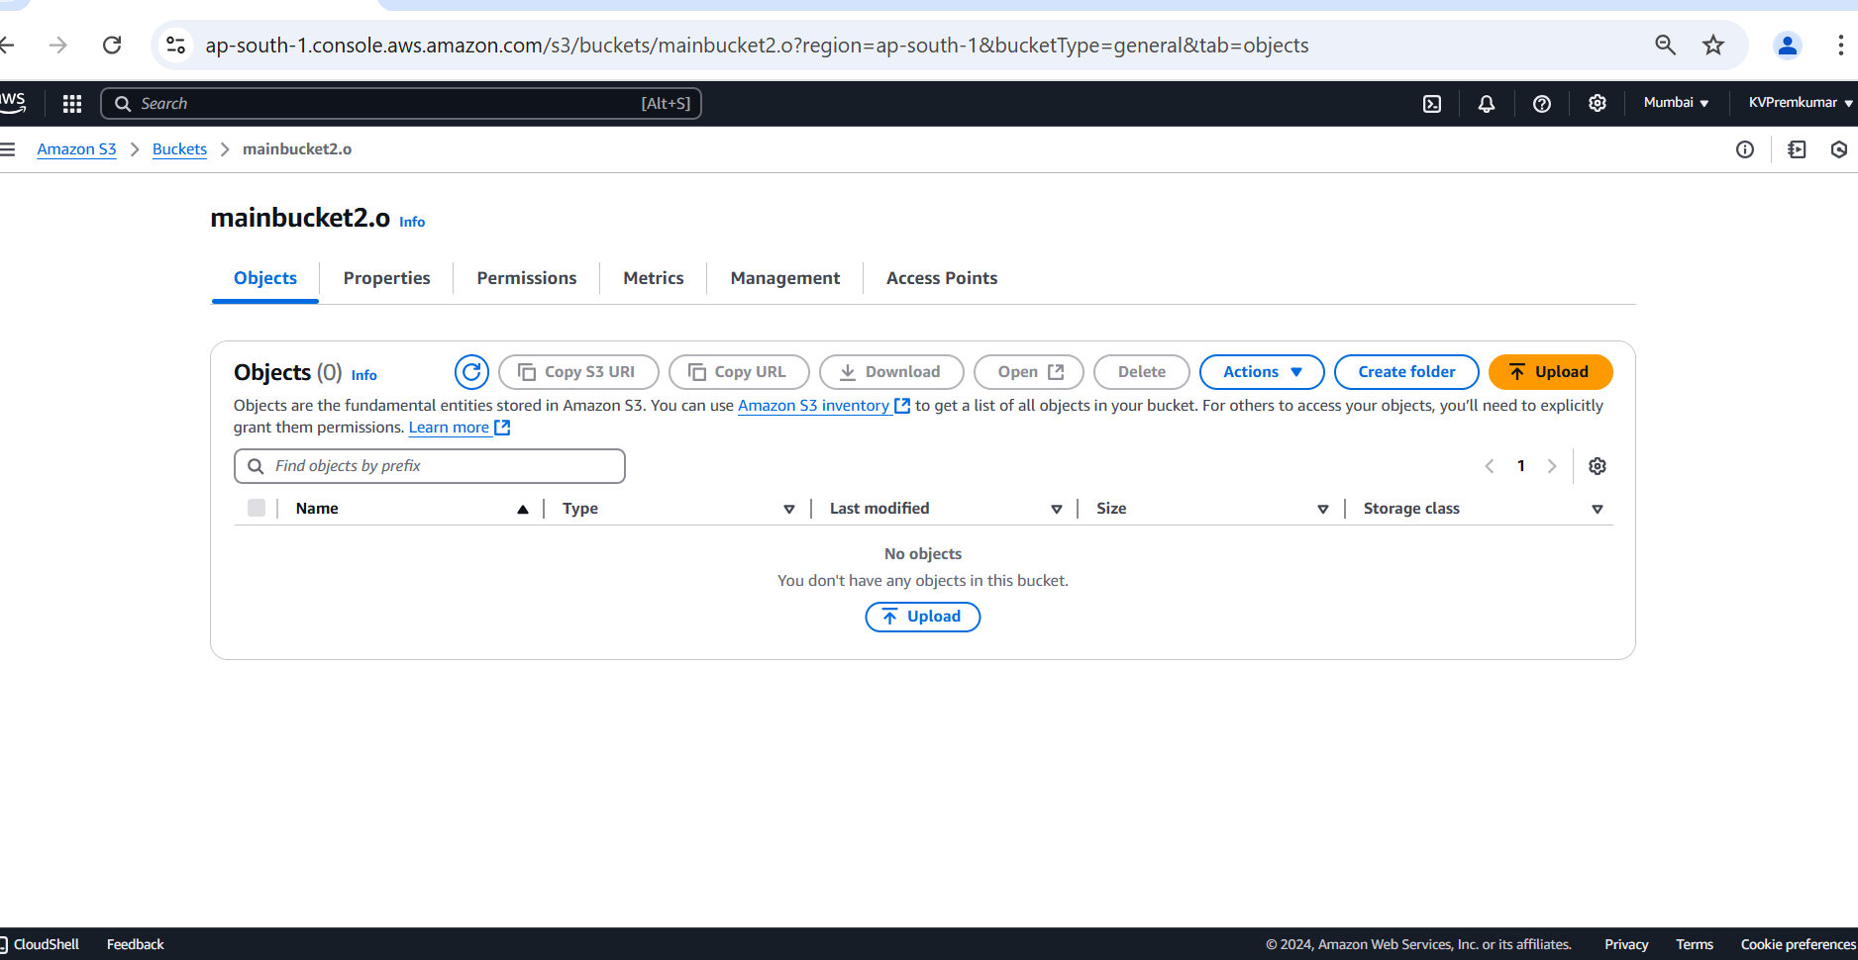
Click on Upload to insert the object (files).

Slide 28
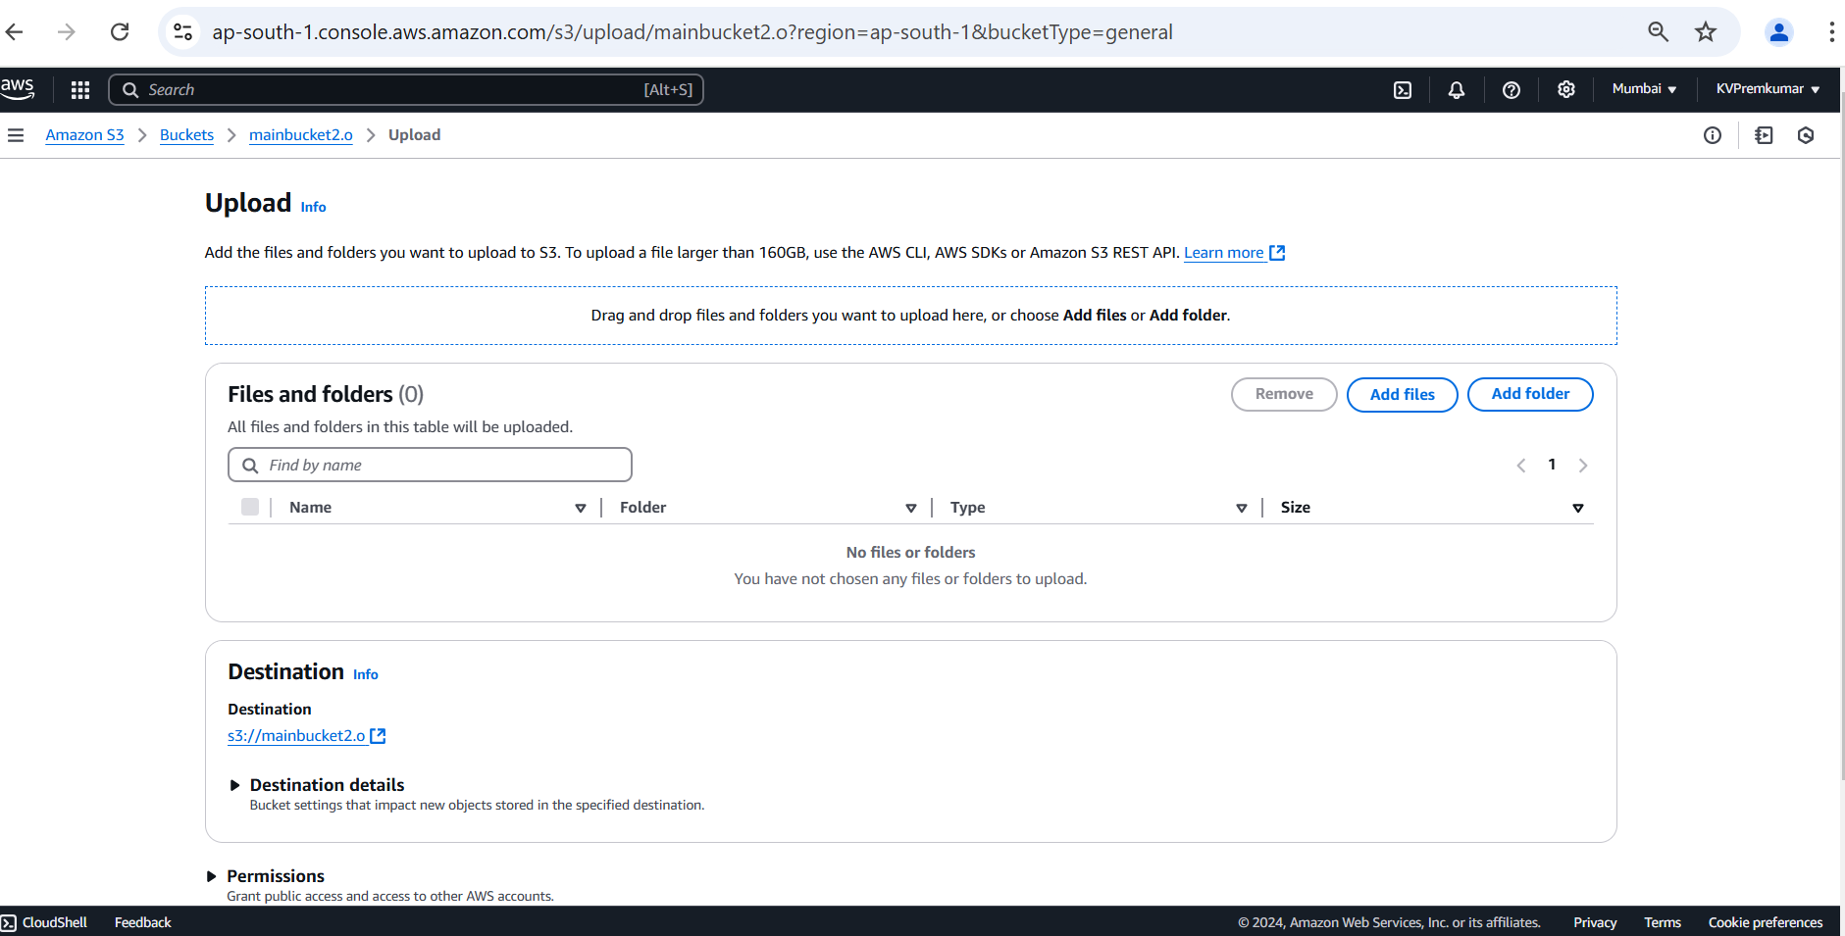
Click on Add files and select the file to upload.

Slide 29
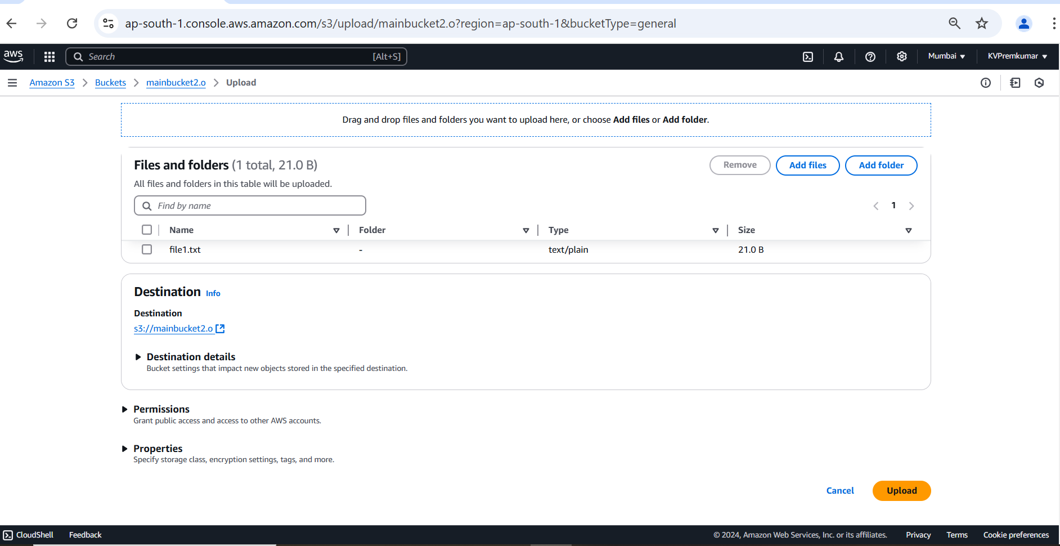
After getting the file keep the remaining options in default and click on Upload.

Slide 30
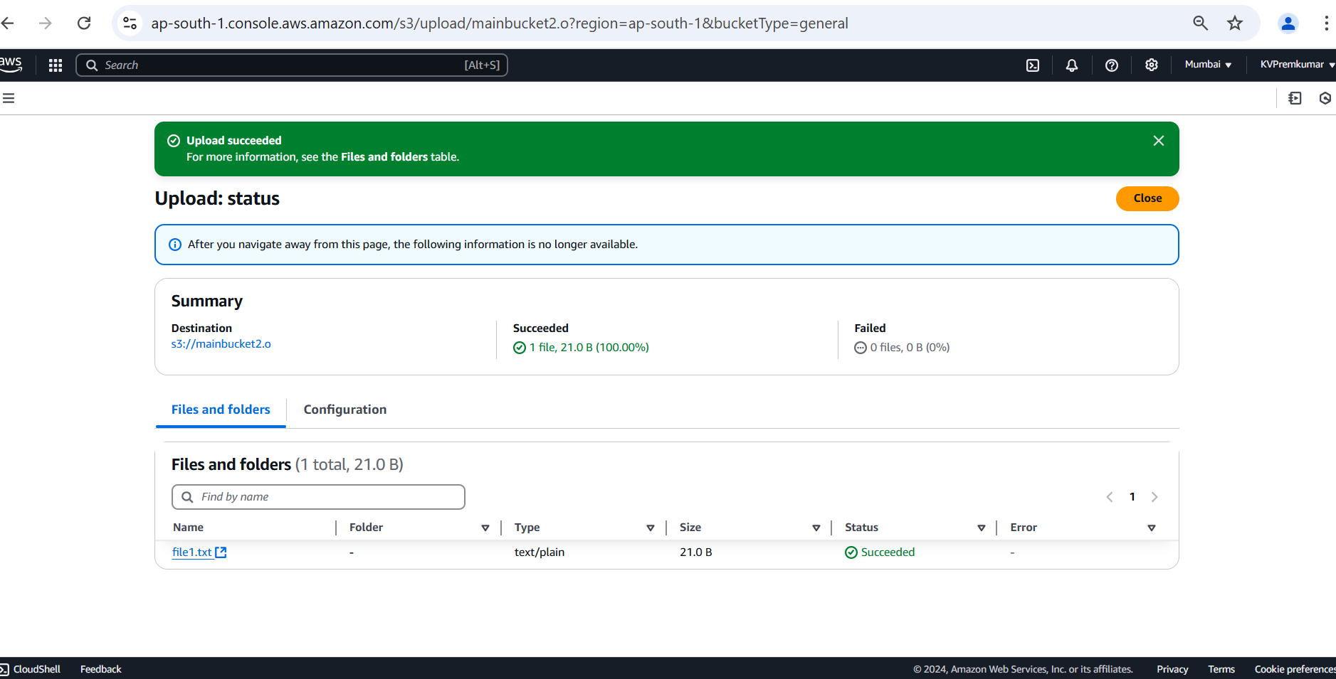
Here we can see the uploading status of the file.

Slide 31
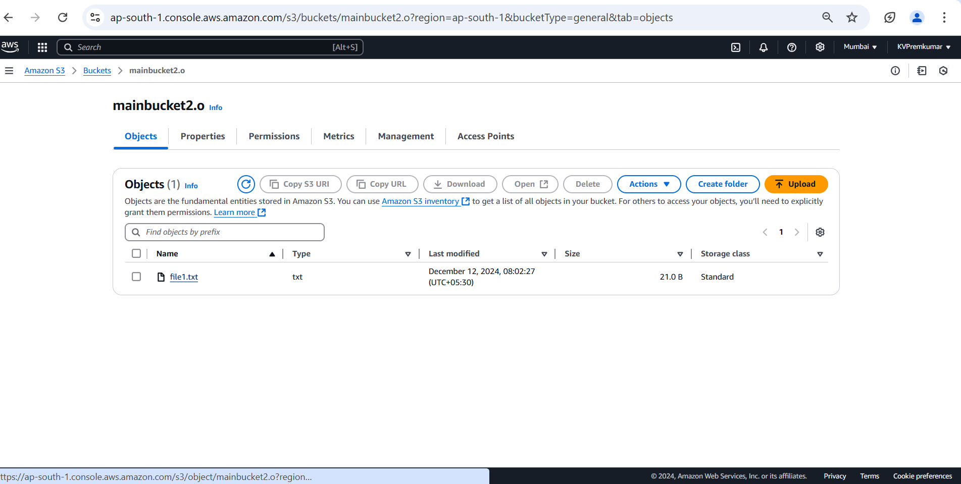
After completion of the upload, you can open the file and see the data in the file by selecting the file and click on Open.

Slide 32
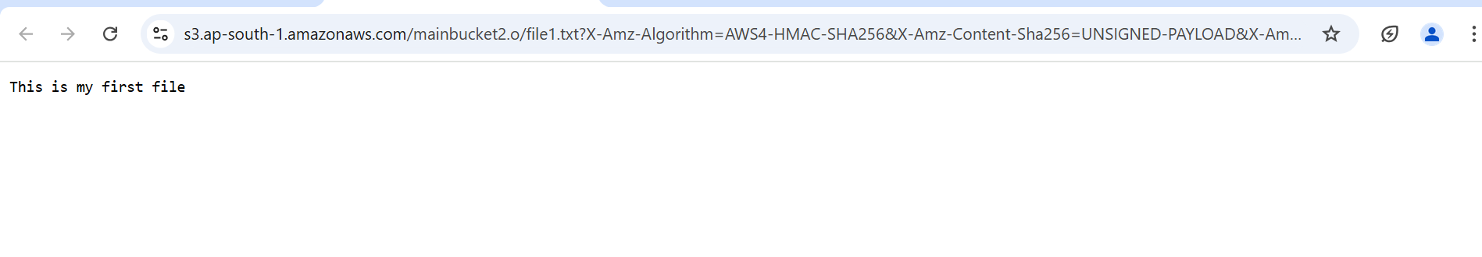
Here we can see the data which is saved in the file

Slide 33
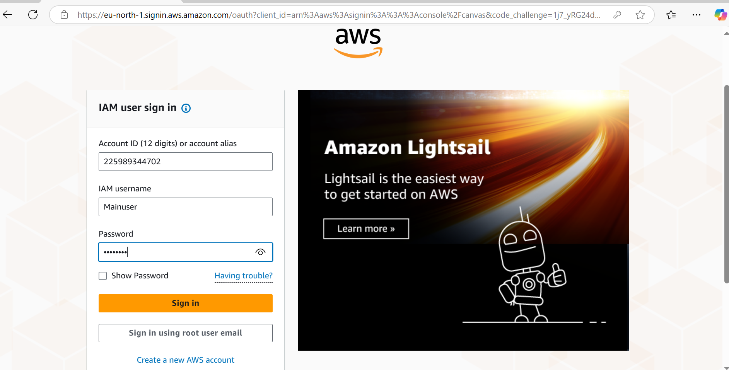
To check the KMS encryption open the IAM user which is having the access of key usage permissions.

Slide 34
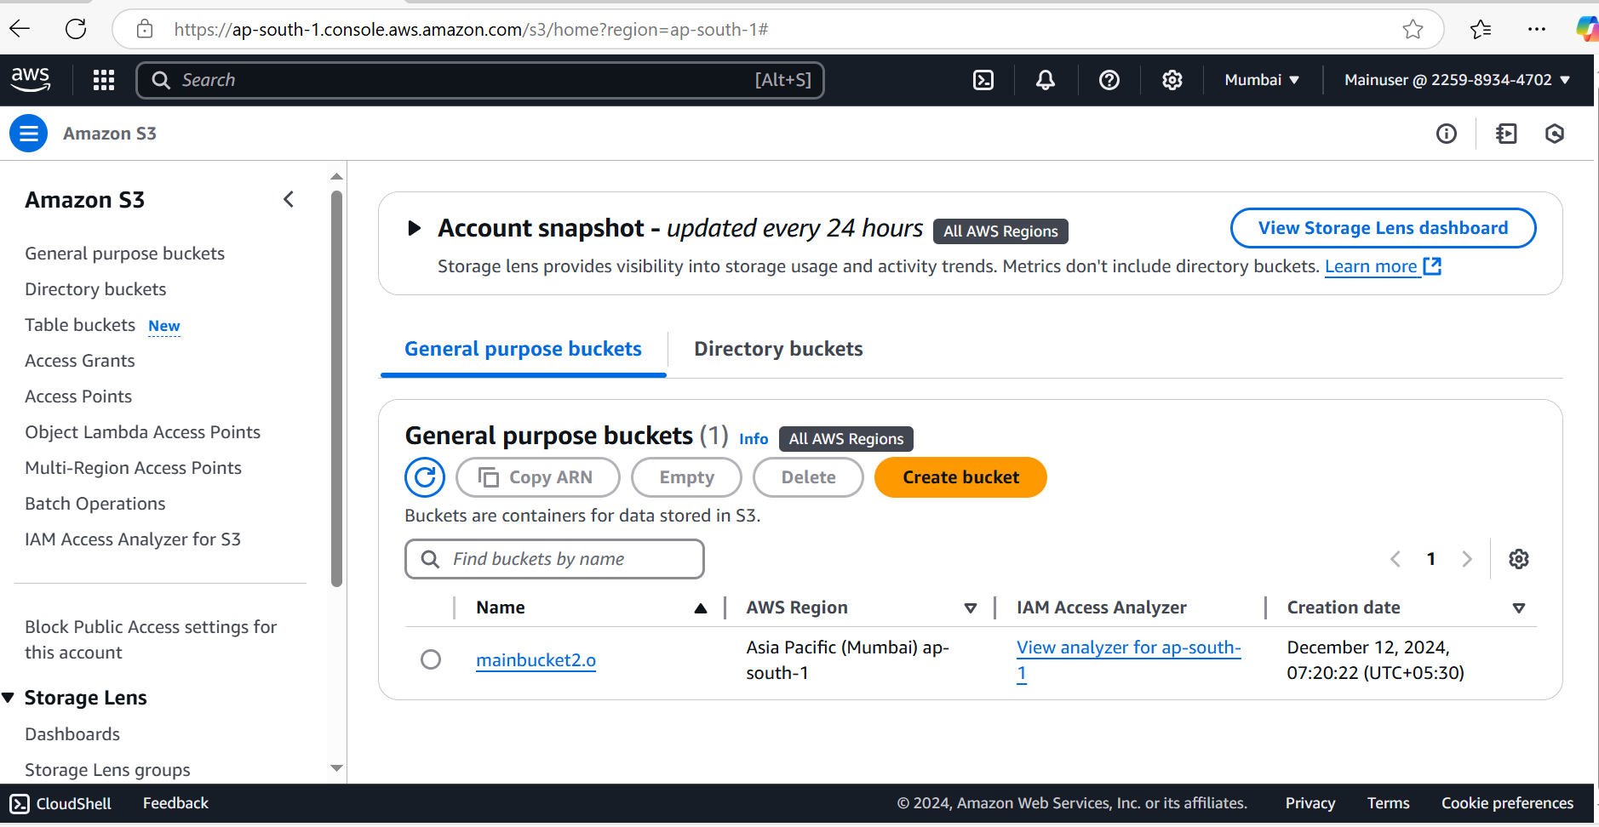
Go to the S3 console and click on the bucket name.

Slide 35
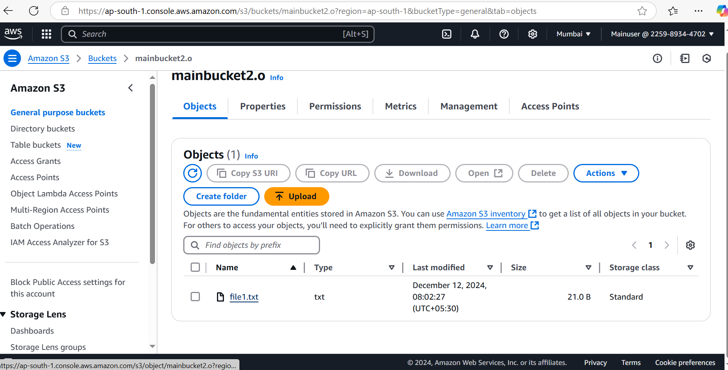
Select the file and click on Open.

Slide 36
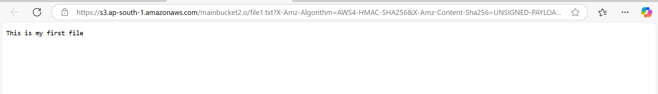
We can see the data in the object because the user having the usage and administrative permissions of KMS.

Slide 37
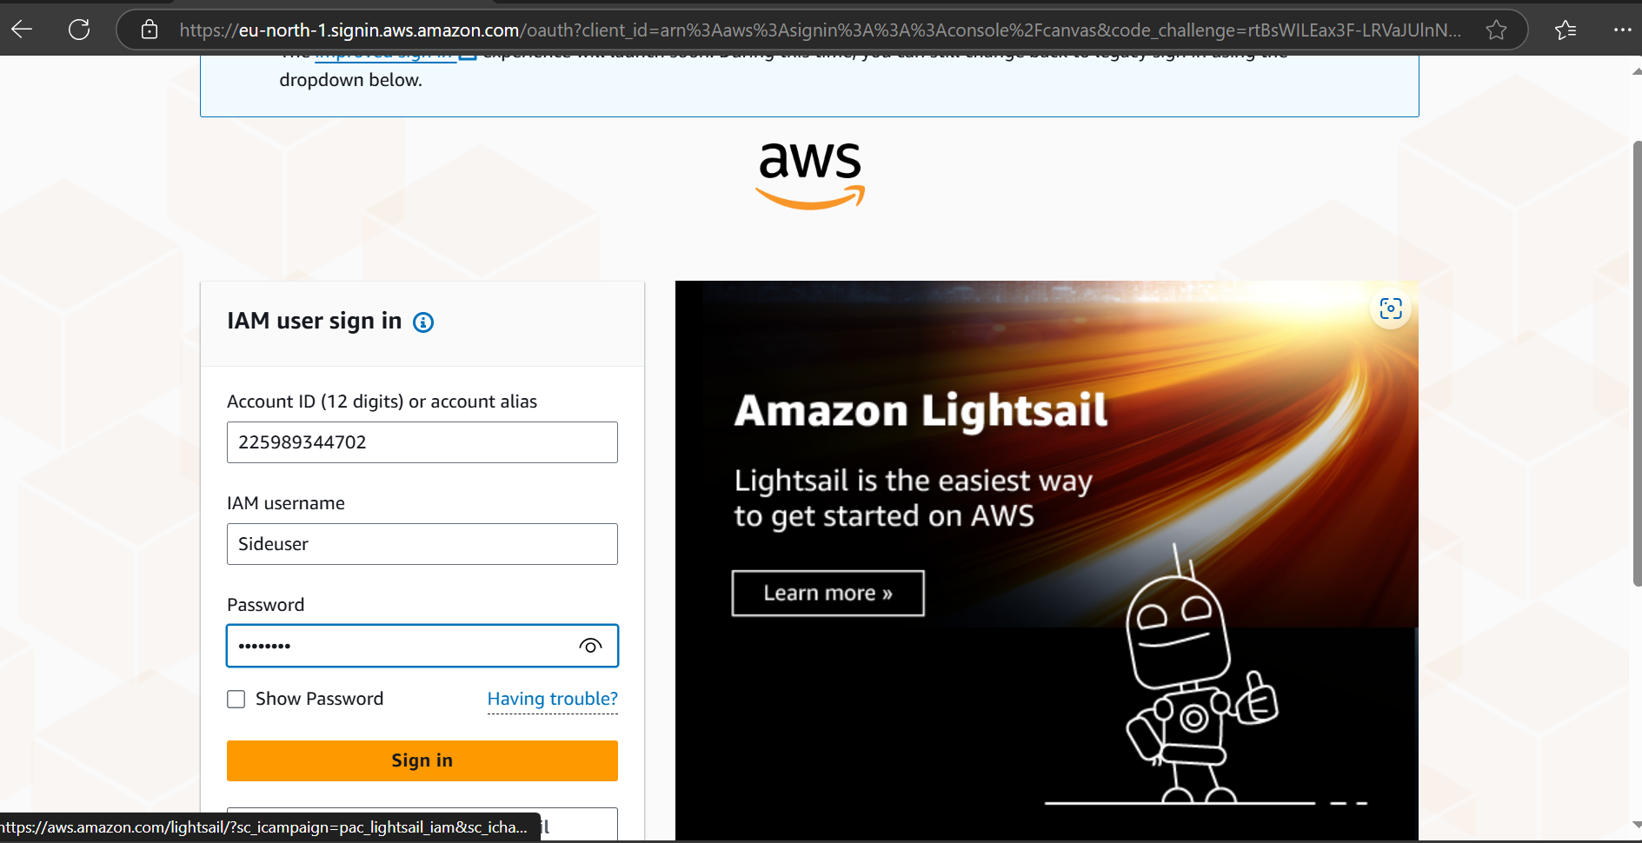
Do the same process with the second user.

Slide 38
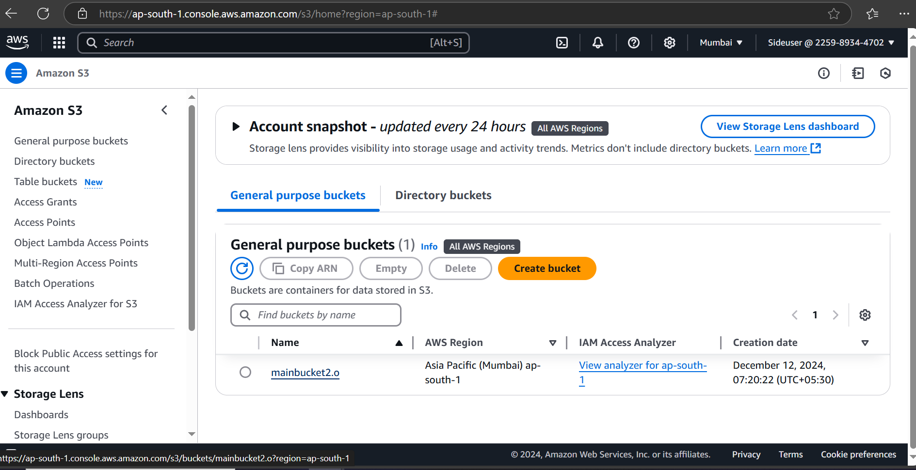

Slide 39
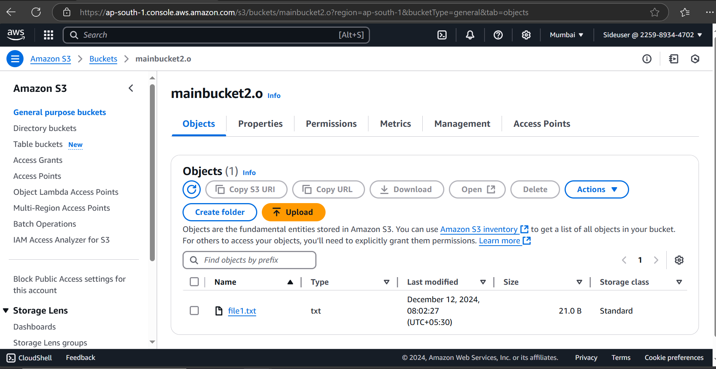

Slide 40
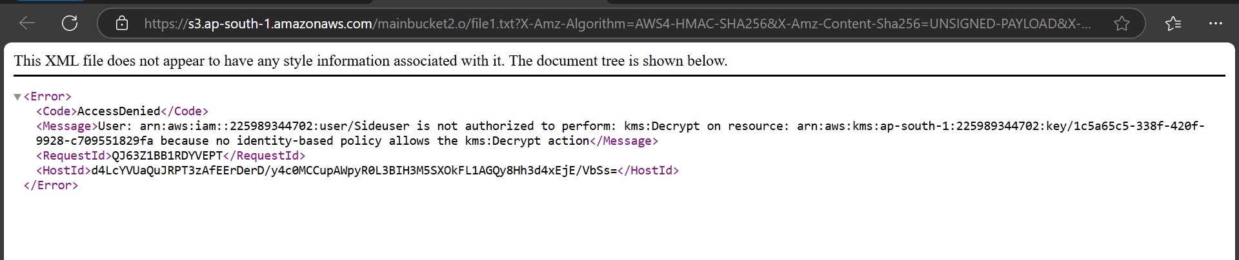
We can see the error code in the file because the user not having the usage and administrative permissions of KMS.

Slide 41
Thankyou

